Slide 1
ML & DS Workshop
Amogh B

Slide 2
Introduction
Machine Learning: Set of Algorithms that can execute tasks without any need for specific instructions solely relying on data patterns.
Data Science: Study of Techniques to find patterns and insights from data.

Slide 3
Understanding
Data Science
Machine Learning
Data Science
Probability
&
Statistics
Domain Knowledge

Slide 4
Applications of Machine Learning & Data Science

Slide 5
Medicine
Predicting Diseases based on Symptoms
Precision Medicine
Detecting Diseases by looking at MRI,ECG,.
Examples:
Detection of Eye Retinopathy-Google AI
Detection of Cancer
Understanding Alzheimer's disease

Slide 6
Agriculture
Predicting if the plant is infested by pests by image processing
Understanding the right plants to grow based on Soil Patterns
Examples:
Precision Agriculture for Development
Skylark Drones

Slide 7
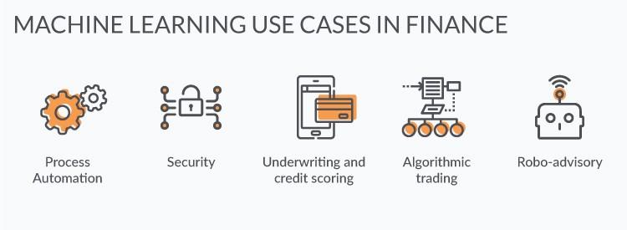
Finance
Predicting Stock Prices
Fraud Detection

Slide 8

Sports
Oakland A’s (baseball team ) used statistical analysis to select players.
Shocked experts when the team went on to record a 20-win streak

Slide 9
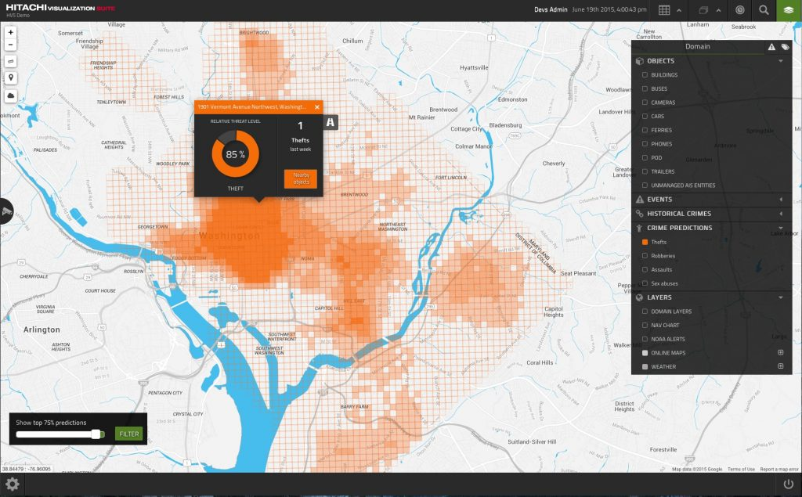
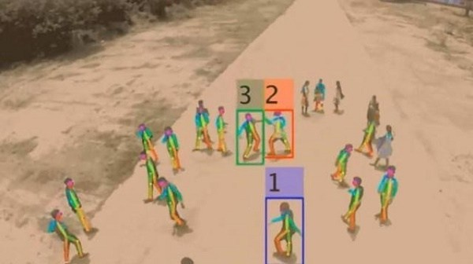
Governance
City planning
Road Traffic Management
Crime Rate Prediction

Slide 10
Python Basics

Slide 11
Python Installation
Use Python 3.x. Python 2.x is mostly obsolete
Default in linux.
Other OS:
Go To :https://www.python.org/downloads/ . Select your OS ,Download & Install

Slide 12
Installing Anaconda
Go to http://docs.anaconda.com/anaconda/install/
Select your OS and Follow Instructions
Anaconda Installs python, jupyter and other necessary packages

Slide 13
Installing Only Jupyter
In linux MacOs run : pip install jupyter
In Windows:
In command prompt go to <directory where python is installed>/python/scripts
Run : pip install jupyter

Slide 14
Necessary Packages
Pandas
Numpy
Matplotlib
Sklearn

Slide 15
Why Python ?
Probably easiest to Learn
Understandable code
Widely used in Machine Learning related fields
Has a wide variety of packages
Also used in Web Dev.

Slide 16
Python Programs
We won’t be using Object Oriented part of python.
Basic understanding is sufficient.
Indentation is important!

Slide 17
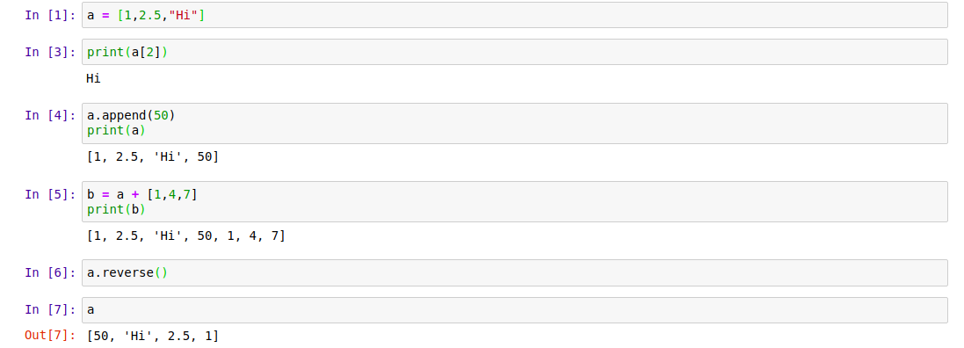
List
Array that can store objects of different types.

Slide 18
Other commands
clear
count
index
sort
Insert

Slide 19
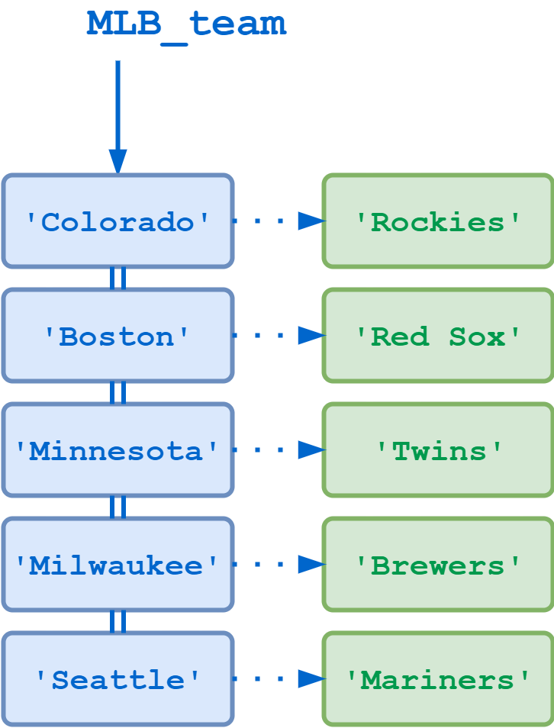
Dictionary
Think as pairs of key:value

Slide 20
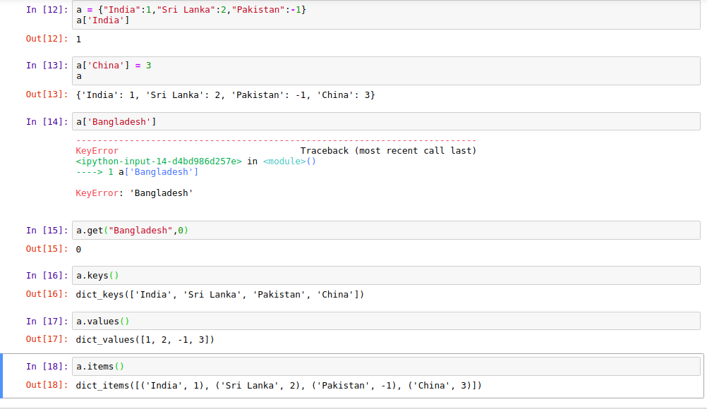

Slide 21
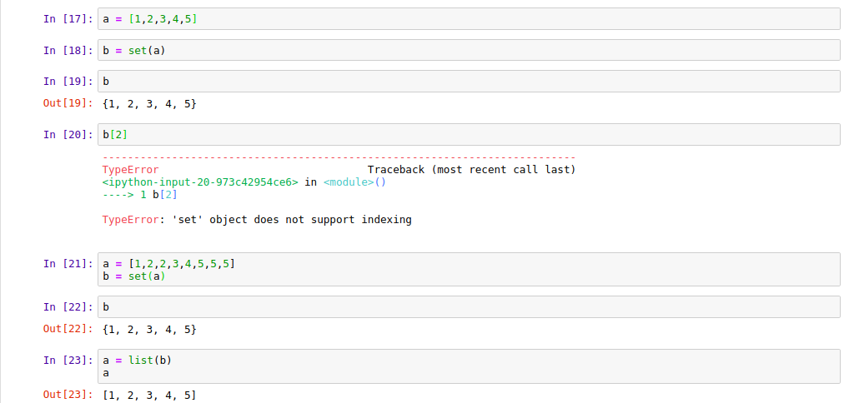
Sets
Unordered list with no repetition

Slide 22
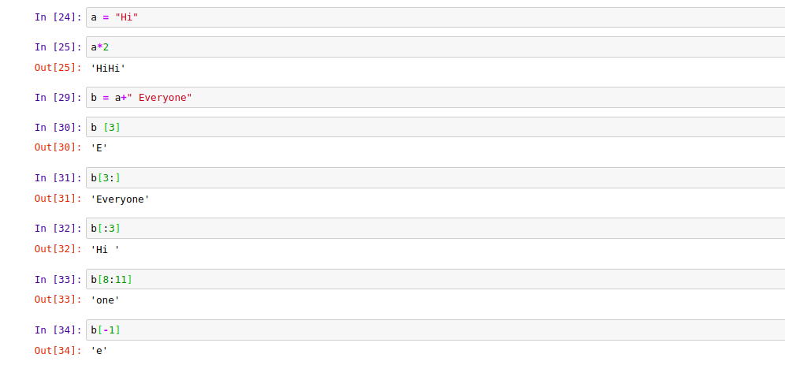
Strings
Treated as character array

Slide 23
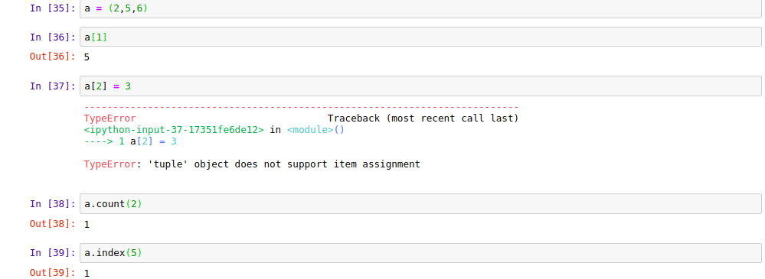
Tuples

Slide 24
Numpy
Installation:pip install numpy
Library for Mathematical Operations
Faster than for loop as it is a vectorized version (ie. it uses parallel processing)

Slide 25
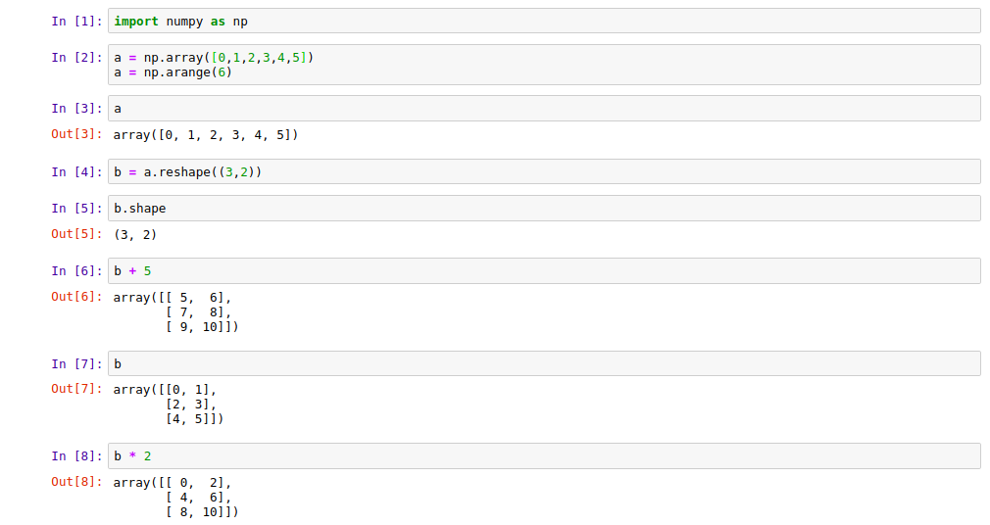
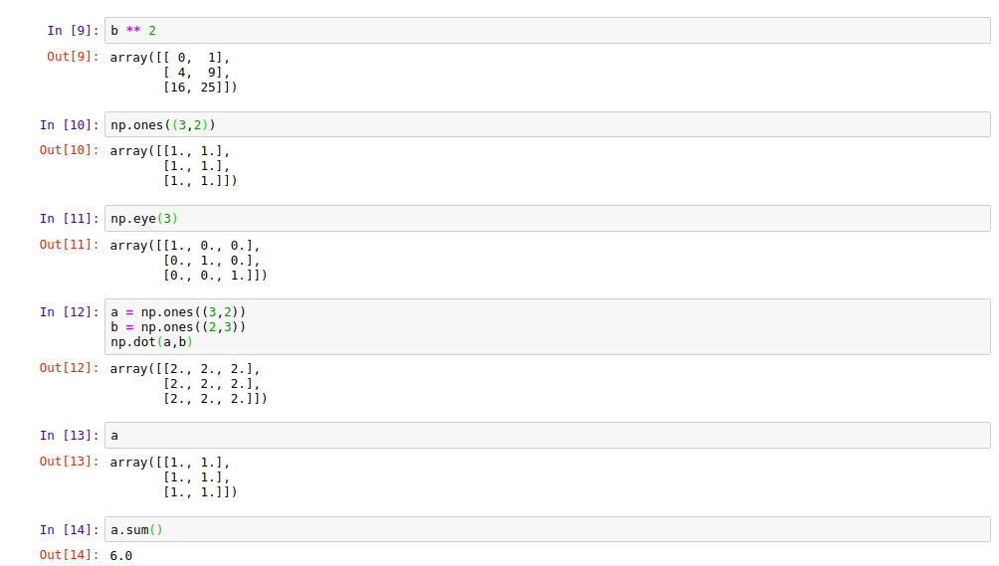

Slide 27
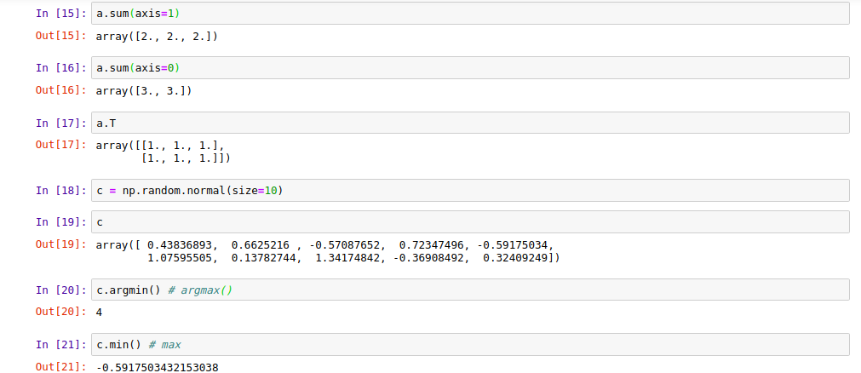

Slide 28
Pandas
Installation : pip install pandas
Pandas Tutorial

